Slide 1
A reflection on types in appreciation of Phil Wadler
Simon Peyton Jones, Stephanie Weirich, Richard Eisenberg, Dimitrios Vytiniotis
Microsoft Research University of Pennsylvania
April 2016

Slide 2
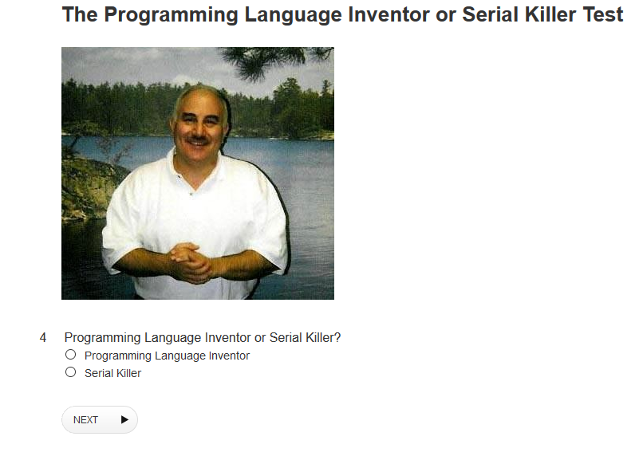

Slide 4
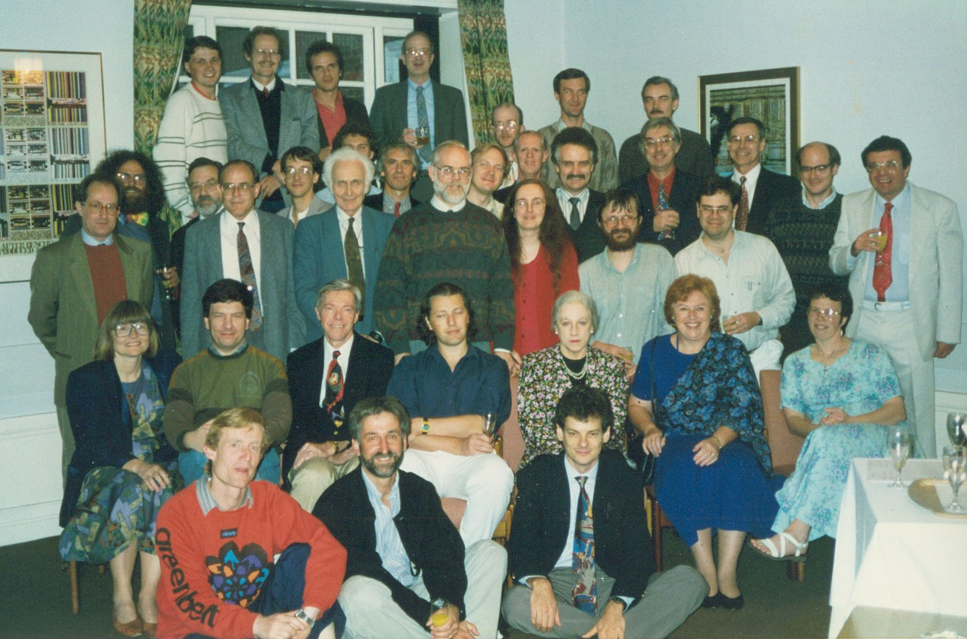
WG2.8 June 1992

Slide 5
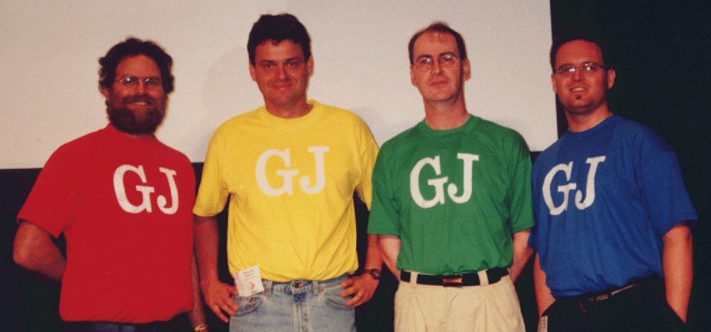

Slide 6
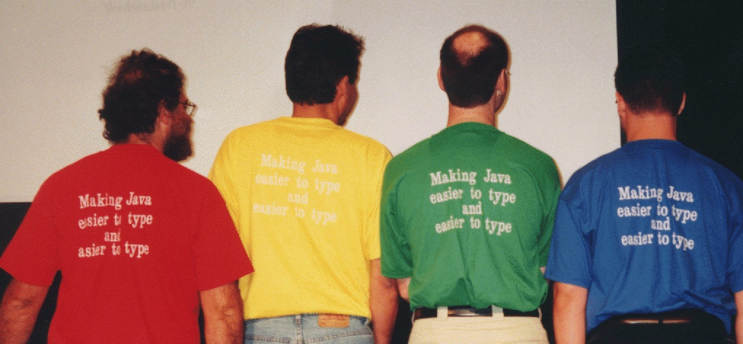

Slide 9
Three word titles

Slide 10
Three word titles

Slide 11
A core calculus for Java
The essence of Java
Boiling Java down
The core of Java
Essential OOP
Java reduced
Featherlite Java

Slide 12
A core calculus for Java
The essence of Java
Boiling Java down
The core of Java
Essential OOP
Java reduced
Featherlite Java

Slide 14
A core calculus for Java
The essence of Java
Boiling Java down
The core of Java
Essential OOP
Java reduced
Featherlite Java
Featherweight Java

Slide 15
CACM Jan 2016

Slide 16
CACM Dec 2015

Slide 17
Bad type systems
Programs that are well typed
All programs
Programs that work
Zone of Abysmal Pain

Slide 18
Sexy type systems
Programs that are well typed
All programs
Programs that work
Smaller Zone of Abysmal Pain

Slide 19
Implementing a store
newSTRef :: a -> ST (STRef a)
readSTRef :: STRef a -> ST a
writeSTRef :: STRef a -> a -> ST ()
Let’s implement this in Haskell, as a state transformer
newtype ST a = MkST (Store -> (a,Store))
But what is a “Store”??

Slide 20
Implementing a store
But what is a “Store”? It maps keys (STRefs) to values of many different types.
Attempt 1: use Data.Map
newtype STRef a = MkSTRef Int
type Store = Map Int ????
lookupStore :: STRef s a -> Store -> Maybe a

Slide 21
Implementing a store
Attempt 2: we need dynamic types, even in a statically typed language
newtype STRef a = MkSTRef Int
type Store = Map Int Dynamic
fromDynamic :: Dynamic -> Maybe a
lookupStore :: STRef a -> Store -> Maybe a
lookupStore (MkSTRef key) store
= case Data.Map.lookup key store of
Nothing -> Nothing
Just d -> fromDynamic d

Slide 22
Implementing a store
Attempt 2: we need dynamic types, even in a statically typed language
Too polymorphic!
See “Theorems for Free”
newtype STRef a = MkSTRef Int
type Store = Map Int Dynamic
fromDynamic :: Dynamic -> Maybe a
lookupStore :: STRef s a -> Store -> Maybe a
lookupStore (MkSTRef key) store
= case Data.Map.lookup store key of
Nothing -> Nothing
Just d -> fromDynamic d

Slide 23
Implementing a store
Attempt 3: enumerate the types we need
data Dynamic = DInt Int | DBool Bool
| DPair Dynamic Dynamic | …etc…
fromDynInt :: Dynamic -> Maybe Int
fromDynBool :: Dynamic -> Maybe Bool
class Dyn a where
fromDynamic :: Dynamic -> Maybe a
lookupStore :: Dyn a => STRef a -> Store -> Maybe a
lookupStore (MkSTRef key) store
= case Data.Map.lookup store key of
Nothing -> Nothing
Just d -> fromDynamic d

Slide 24
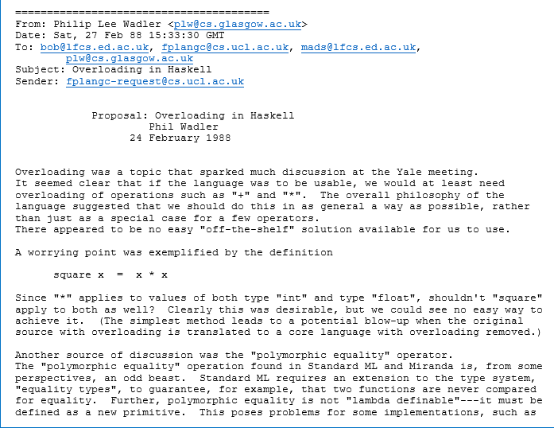
The birth of type classes

Slide 25
Implementing a store
Attempt 3: enumerate the types we need
data Dynamic = DInt Int | DBool Bool
| DPair Dynamic Dynamic | …etc…
Non-starter because it requires a closed world
We want
readSTRef :: STRef a -> ST a
to work for any type ‘a’, including new ones
Also: converting to and fro takes a deep traversal

Slide 26
What’s in a Dynamic?
A Dynamic should consist of
The value itself
A runtime representation of its type
data Dynamic where
Dyn :: TypeRep a -> a -> Dynamic
Runtime representation of the type of the value
The value itself
A type-indexed data structure

Slide 27
Q1: where do TypeReps come from?
class Typeable a where
typeRep :: TypeRep a
toDynamic :: Typeable a => a -> Dynamic
toDynamic x = Dyn typeRep x
data Dynamic where
Dyn :: TypeRep a -> a -> Dynamic
No deep traversal
Instances of Typeable are built in
data Wurble a = MkWurble a | …
-- Implicitly you get
-- instance Typeable a => Typeable (Wurble a)

Slide 28
Q1: where do TypeReps come from?
class Typeable a where
typeRep :: TypeRep a
toDynamic :: Typeable a => a -> Dynamic
toDynamic x = Dyn typeRep x
newtype Typeable a = MkT (TypeRep a)
toDynamic :: Typeable a -> a -> Dynamic
toDynamic (MkT tr) x = Dyn tr x
data Wurble a = MkWurble a | …
-- Implicitly you get
-- instance Typeable a => Typeable (Wurble a)
$tWurble :: Typeable a -> Typeable (Wurble a)
$tWurble (MkT tra) = MkT (mkTrApp “Wurble” [tra])

Slide 29
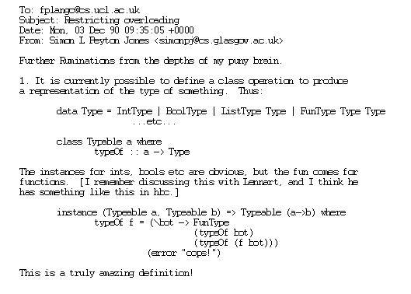
The birth of TypeRep

Slide 30
Q2: what can you do with TypeRep?
data Dynamic where
Dyn :: TypeRep a -> a -> Dynamic
fromDynamic :: ∀b. Typeable b => Dynamic -> Maybe b
fromDynamic (Dyn (ra :: TypeRep a) (x::a))
= let rb = typeRep :: TypeRep b
in case ra == rb of
True -> Just x
False -> Nothing

Slide 31
Q2: what can you do with TypeRep?
data Dynamic where
Dyn :: TypeRep a -> a -> Dynamic
fromDynamic :: ∀b. Typeable b => Dynamic -> Maybe b
fromDynamic (Dyn (ra :: TypeRep a)) (x::a)
= let rb = typeRep :: TypeRep b
in case ra == rb of
True -> Just x
False -> Nothing
Type error 2
Just x :: Maybe a,
but we need Maybe b
Type error 1
ra :: TypeRep a
but rb :: TypeRep b

Slide 32
We need type-aware equality!
Fix error 1 compares TypeReps with different indices
eqT :: TypeRep a -> TypeRep b -> Maybe (a :=: b)
data a :=: b where
Refl :: a :=: a
fromDynamic :: ∀b. Typeable b => Dynamic -> Maybe b
fromDynamic (Dyn (ra :: TypeRep a)) (x::a)
= let rb = typeRep :: TypeRep b
in case ra `eqT` rb of
Just Refl -> Just x
Nothing -> Nothing
Fix error 2
In here we know that a ~ b
Refl :: ∀ab. (a~b) => a :=: b

Slide 33
Do notation for the Maybe monad
eqT :: TypeRep a -> TypeRep b -> Maybe (a :=: b)
data a :=: b where
Refl :: a :=: a
fromDynamic :: ∀b. Typeable b => Dynamic -> Maybe b
fromDynamic (Dyn (ra :: TypeRep a)) (x::a)
= do { Refl <- ra `eqT` (typeRep :: TypeRep b)
; return x }
Use do-notation
(convenience only)

Slide 34
Where have we got to?
ST library
Type-safe reflection
Small trusted code base
Smaller, more re-usable primitive than Dynamic
Store
Type-safe
Data.Map
Dynamic, fromDynamic, toDynamic
Trusted code base
TypeRep a, Typeable a eqT :: TypeRep a -> TypeRep b -> Maybe (a :=: b)

Slide 35
What next?
dynHead :: Dynamic -> Maybe Dynamic
Return Nothing if the argument Dynamic turns out not to be a list

Slide 36
Decomposing TypeRep
dynHead :: Dynamic -> Maybe Dynamic
dynHead (Dyn (rxs :: TypeRep txs) (xs :: txs))
| …txs looks like [tx]…
…rxs looks like [rx]…
= Just (Dyn rx (head xs))
| otherwise
= Nothing

Slide 37
Decomposing TypeRep
dynHead :: Dynamic -> Maybe Dynamic
dynHead (Dyn (rxs :: TypeRep txs) (xs :: txs))
| …txs looks like [tx]…
…rxs looks like [rx]…
= Just (Dyn rx (head xs))
| otherwise
= Nothing
This should be [tx] but it’s actually txs

Slide 38
Decomposing TypeRep
dynHead :: Dynamic -> Maybe Dynamic
dynHead (Dyn (rxs :: TypeRep txs) (xs :: txs))
= do { App rl rx <- splitApp rxs
; Refl <- rl `eqT` (typeRep :: TypeRep [])
; return (Dyn rx (head xs)) }
Decompose rxs into (rl rx)
Check that rl = []

Slide 39
Decomposing TypeRep
dynHead :: Dynamic -> Maybe Dynamic
dynHead (Dyn (rxs :: TypeRep txs) (xs :: txs))
= do { App rl rx <- splitApp rxs
; Refl <- rl `eqT` (typeRep :: TypeRep [])
; return (Dyn rx (head xs)) }
data AppResult t where
App :: TypeRep a -> TypeRep b -> TypeRep (a b)
splitApp :: TypeRep t -> Maybe (AppResult t)

Slide 40
Kind polymorphism
dynHead :: Dynamic -> Maybe Dynamic
dynHead (Dyn (rxs :: TypeRep txs) (xs :: txs))
= do { App rl rx <- splitApp rxs
; Refl <- rl `eqT` (typeRep :: TypeRep [])
; return (Dyn rx (head xs)) }
Representation of the list type constructor
TypeRep :: ∀k. k -> *
Argument can be of any kind

Slide 41
Kind polymorphism
data AppResult t where
App :: TypeRep a -> TypeRep b -> TypeRep (a b)
App :: ∀ kr kb (r::kr) (a::kb->kr) (b::kb).
(r ~ a b)
=> TypeRep a -> TypeRep b -> TypeRep r
dynHead :: Dynamic -> Maybe Dynamic
dynHead (Dyn (rxs :: TypeRep txs) (xs :: txs))
= do { App rl rx <- splitApp rxs
; Refl <- rl `eqT` (typeRep :: TypeRep [])
; return (Dyn rx (head xs)) }

Slide 42
New problem!
App :: ∀ kr kb (r::kr) (a::kb->kr) (b::kb).
(r ~ a b)
=> TypeRep a -> TypeRep b -> TypeRep r
dynHead :: Dynamic -> Maybe Dynamic
dynHead (Dyn (rxs :: TypeRep txs) (xs :: txs))
= do { App rl rx <- splitApp rxs
; Refl <- rl `eqT` (typeRep :: TypeRep [])
; return (Dyn rx (head xs)) }
rl :: TypeRep (a :: kb->*)
TypeRep ([] :: *->*)

Slide 43
New problem!
App :: ∀ kr kb (r::kr) (a::kb->kr) (b::kb).
(r ~ a b)
=> TypeRep a -> TypeRep b -> TypeRep r
dynHead :: Dynamic -> Maybe Dynamic
dynHead (Dyn (rxs :: TypeRep txs) (xs :: txs))
= do { App rl rx <- splitApp rxs
; Refl <- rl `eqT` (typeRep :: TypeRep [])
; return (Dyn rx (head xs)) }
rl :: TypeRep (a :: kb->*)
TypeRep ([] :: *->*)
Conclusion: eqT must be herero-kinded

Slide 44
Kind equalities
a and b can have different kinds
eqT :: ∀ k1 k1 (a::k1) (b::k2).
TypeRep a -> TypeRep b -> Maybe (a :=: b)
data a :=: b where
Refl :: a :=: a
Refl :: ∀ k1 k2 (a::k1) (b::k2).
(k1 ~ k2, a ~ b) => a :=: b
Matching against Refl gives us a kind equality as well as a type equality

Slide 45
Where does that leave us?
Type-safe reflection, with extensible dynamic types, and a small trusted code base
Requires some Heavy Duty Type Artillery
Type classes
GADTs and local type equalities
Kind polymorphism
Kind-heterogeneous type equalities
Local kind equalities
Type support implemented in GHC 8.0 TypeRep library changes in GHC 8.2

